Slide 1


Slide 2
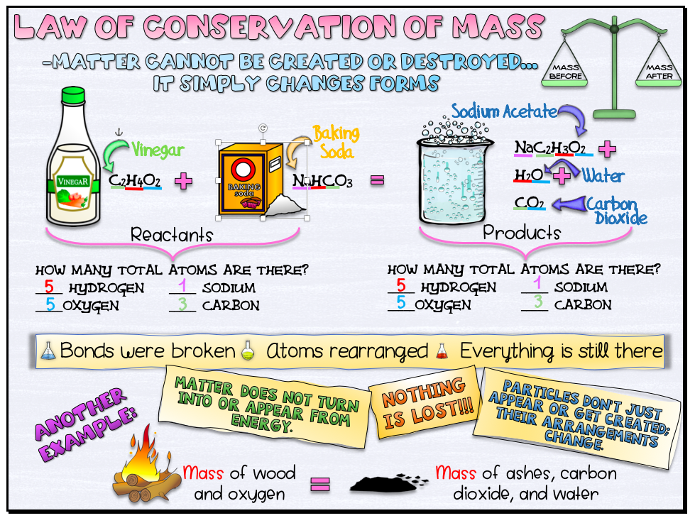

Slide 3

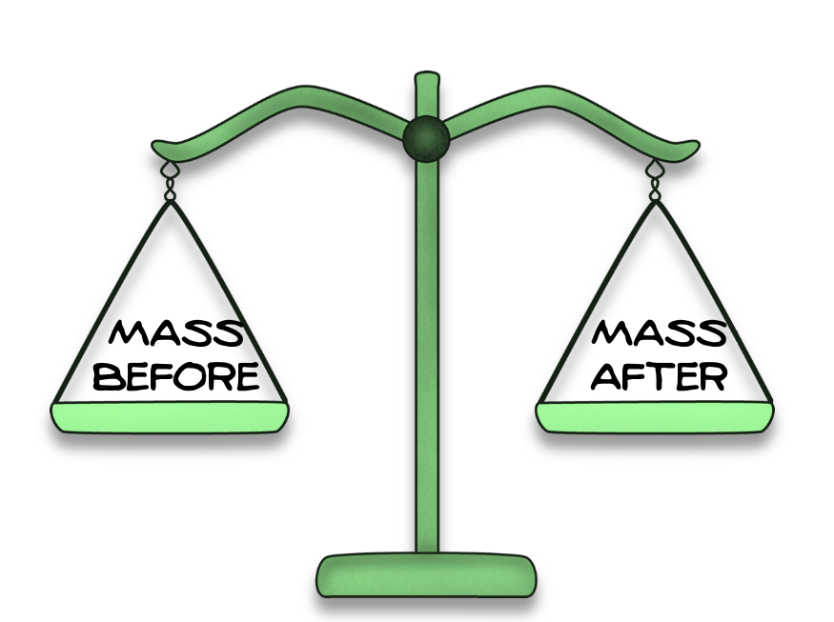

Slide 4
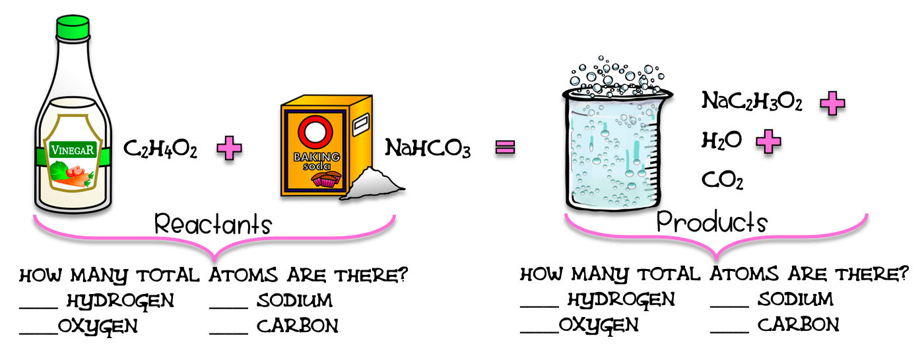

Slide 5
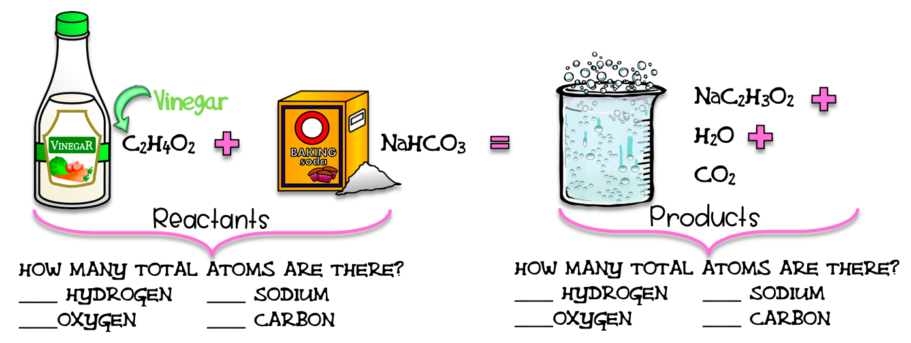

Slide 6
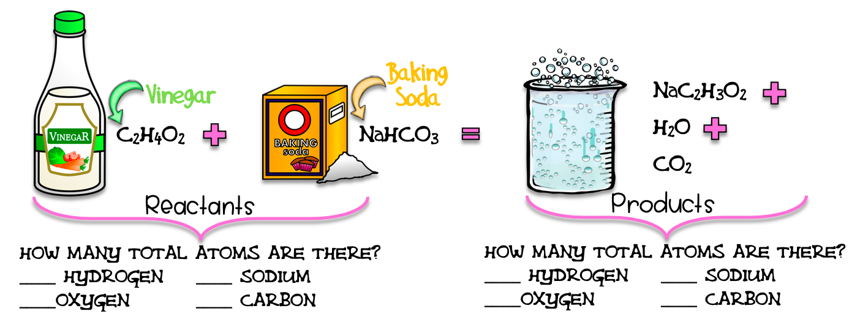

Slide 7

Directions: Underline the hydrogen in the reactants in red.

Slide 8
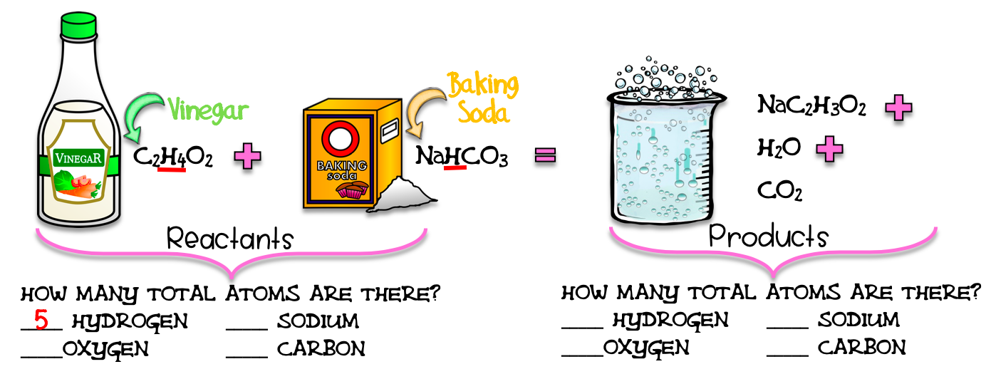
Directions: Count them and record.

Slide 9


Directions: Underline the oxygen in the reactants in blue.

Slide 10

Directions: Count them and record.

Slide 11

Directions: Underline the sodium in the reactants in purple.

Slide 12

Directions: Count them and record.

Slide 13
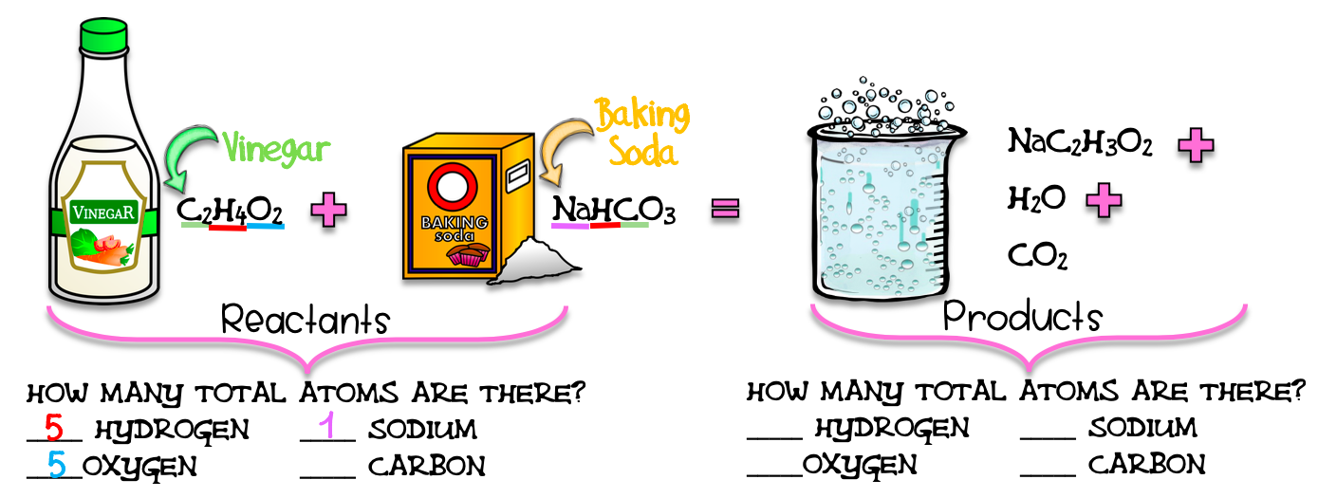
Directions: Underline the carbon in the reactants in green.

Slide 14

Directions: Count them and record.

Slide 15
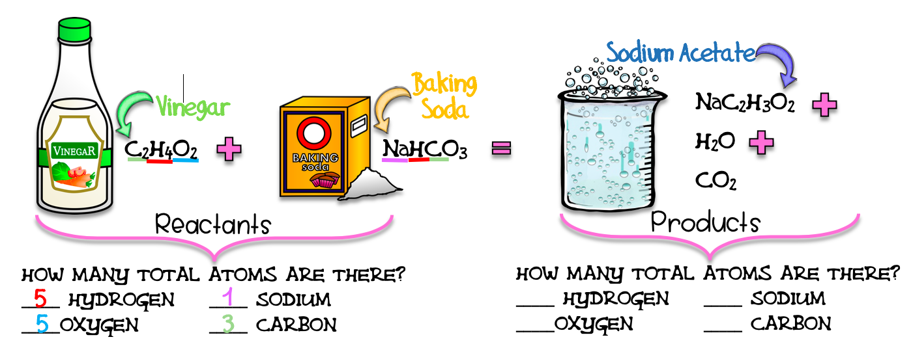

Slide 16
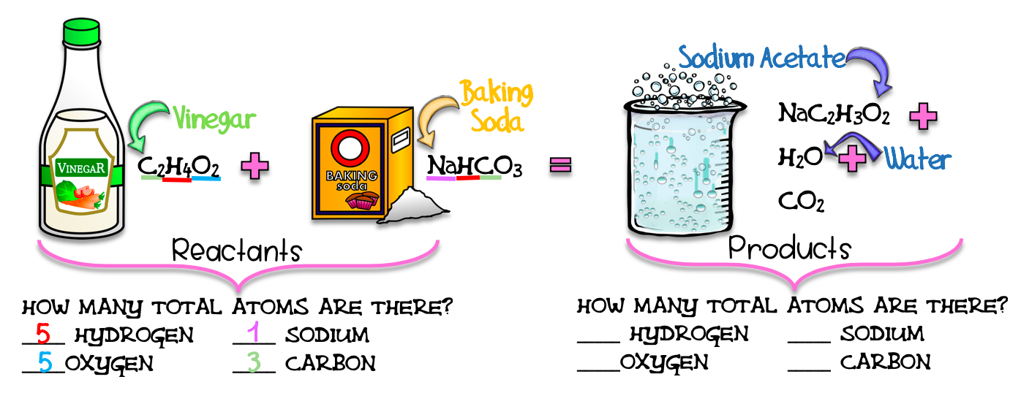

Slide 17
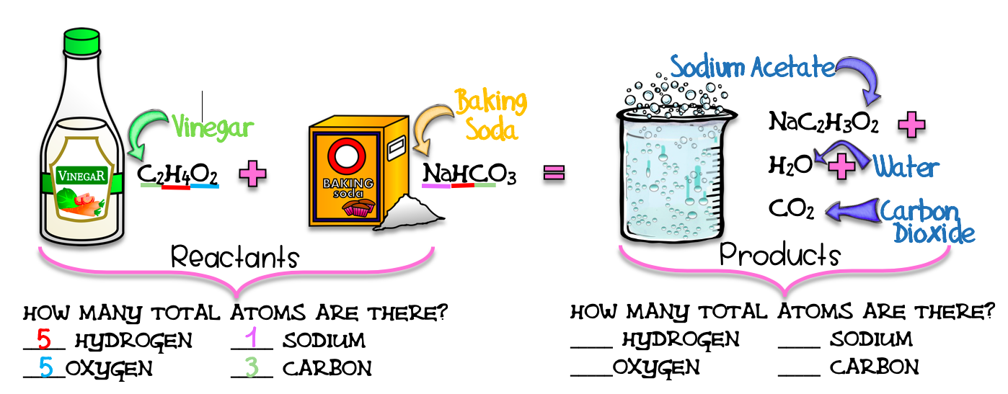

Slide 18
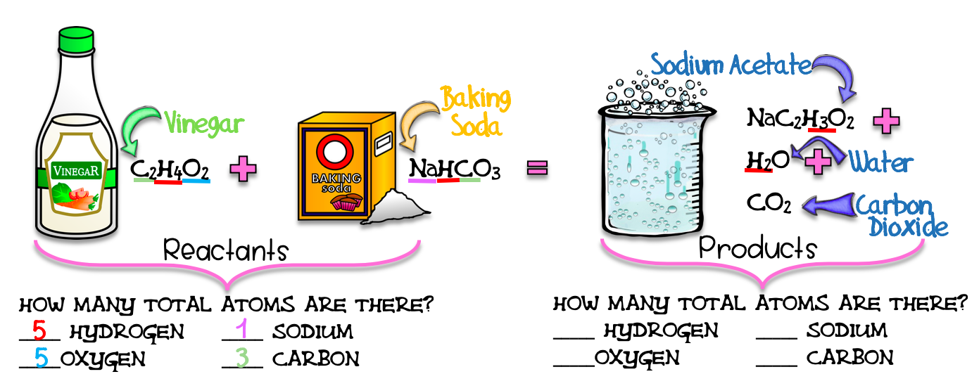
Directions: Underline the hydrogen in the products in red.

Slide 19
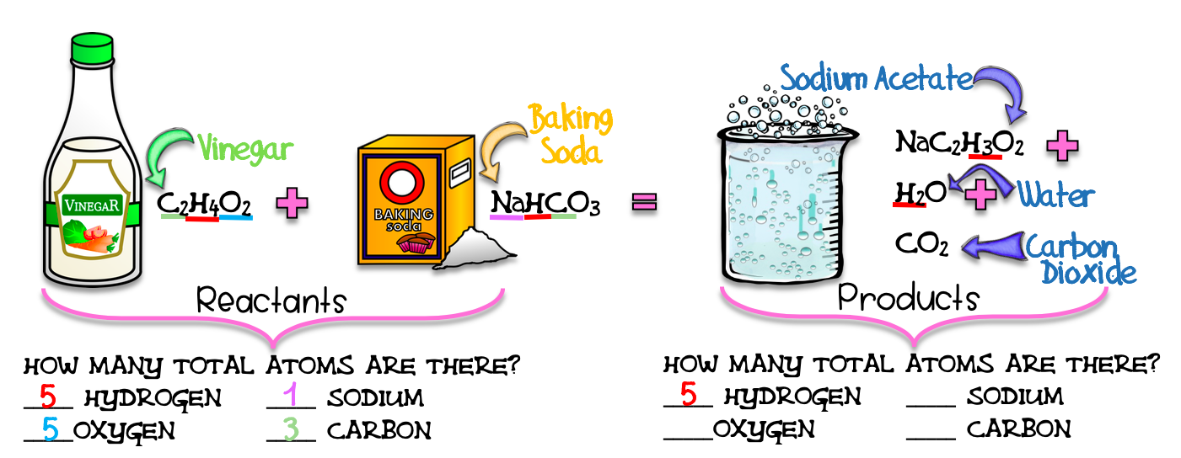
Directions: Count them and record.

Slide 20
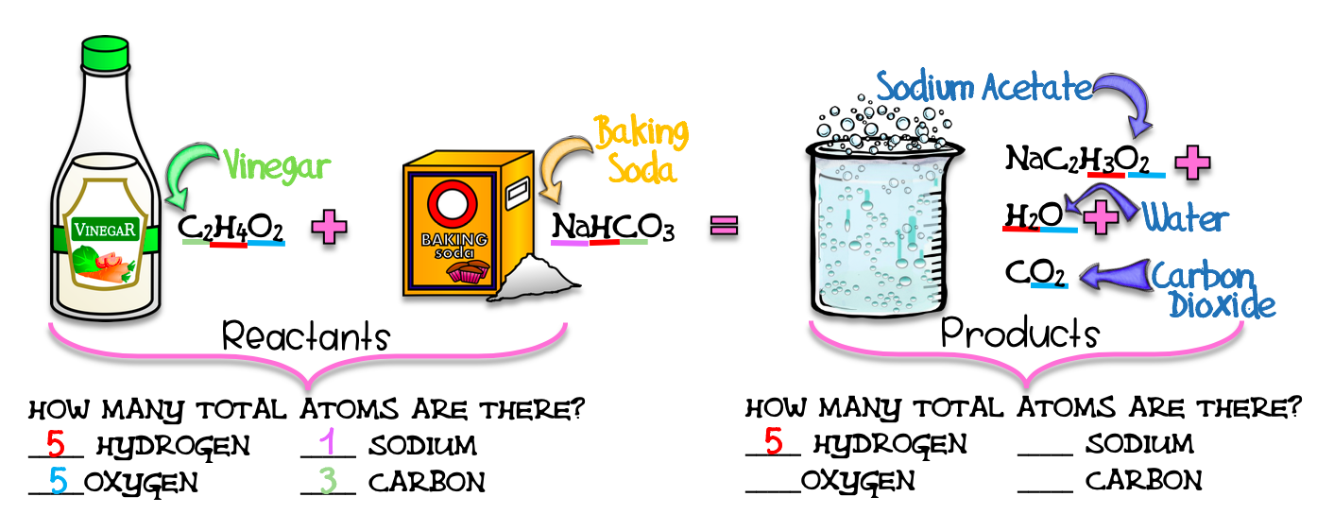
Directions: Underline the oxygen in the products in blue.

Slide 21
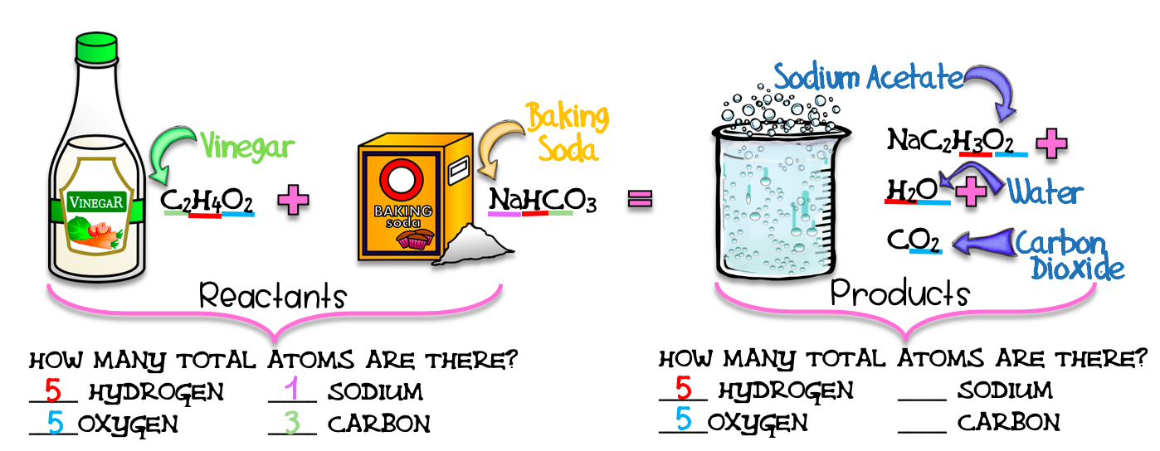
Directions: Count them and record.

Slide 22
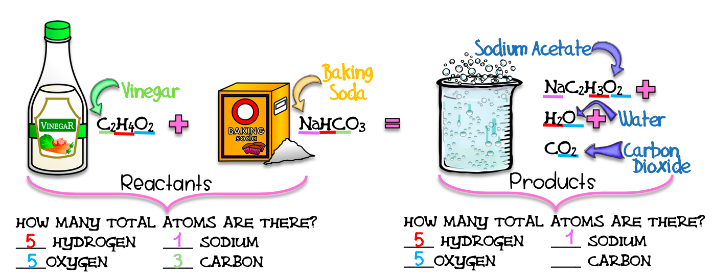
Directions: Underline the sodium in the products in purple.

Slide 23
Directions: Count them and record.

Slide 24

Directions: Underline the carbon in the products in green.

Slide 25

Directions: Count them and record.

Slide 26


Slide 27


Slide 28


Slide 29




Slide 30



Slide 31



Slide 32
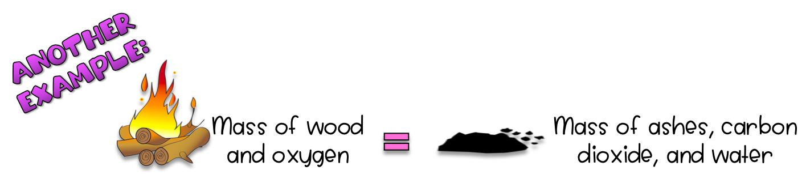

Slide 33
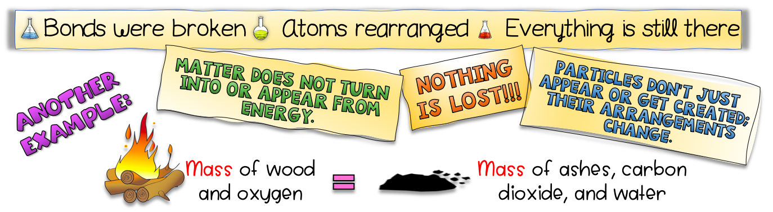

Slide 35
Credits and Copyright
Black-Eyed Susan Science
Next Generation Science Standards
Kimberly Geswein Fonts
https://images.app.goo.gl/mh1EHhmhR6ekQAte9
KB3Teach
The 3am Teacher
The Cher Room
The Painted Crow
Sarah Pecorino Illustration
Teachers Resource Force

